Slide 1
Session 1 -
Exploratory Data Analysis
Jordi Coscolla

Slide 2
Exploratory Data Analysis
Refers to the critical process of performing initial investigations on data so as to discover patterns,to spot anomalies,to test hypothesis and to check assumptions with the help of summary statistics and graphical representations.
Notes:
Basically… know more about your data and be able to have assumptions that you can test and verify later
Also, create a story for the data that you can share with others

Slide 3
Jupyter
Jupyter is a web REPL for python:
Allow us to store all the steps for our conclusions
Easy to share
Good for playing with data

Slide 4
Install Jupyter
Activate the environment of last session
source env/bin/activate (env is the environment folder created las time)
Install jupyter (well I will install couple of more things xD)
pip3 install jupyter seaborn matplotlib pandas
Execute Jupyter notebook (a webpage should open)
jupyter notebook .

Slide 5
Using Jupyter
Create a new notebook
Shift + Enter: Executes the cells
Variables are shared between cells
Different type of cells (MarkDown / python etc..)
The last expression is what is shown
Some expressions have better formats
Plots
DataFrames
https://s3.amazonaws.com/assets.datacamp.com/blog_assets/Jupyter_Notebook_Cheat_Sheet.pdf

Slide 6
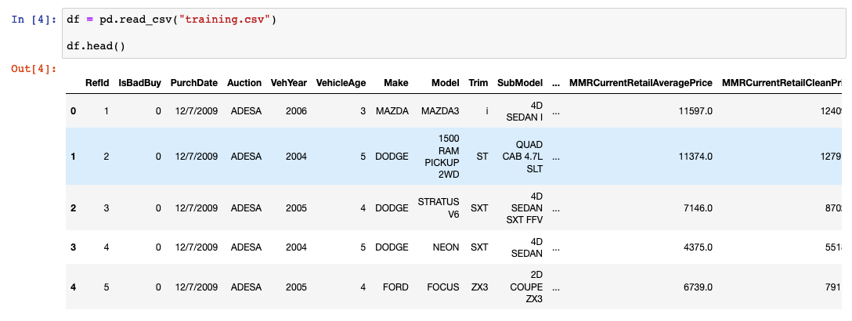
Loading the data

Slide 7
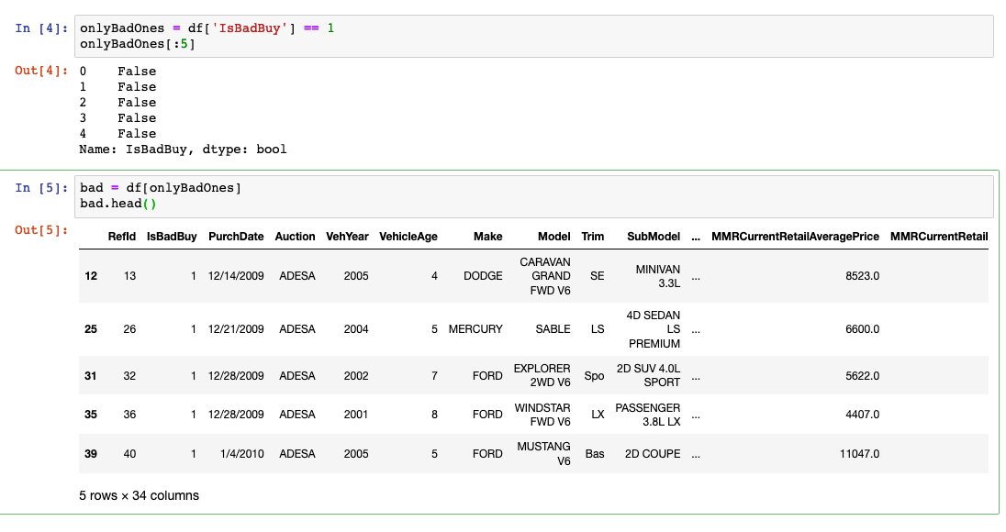
Filtering the data

Slide 8
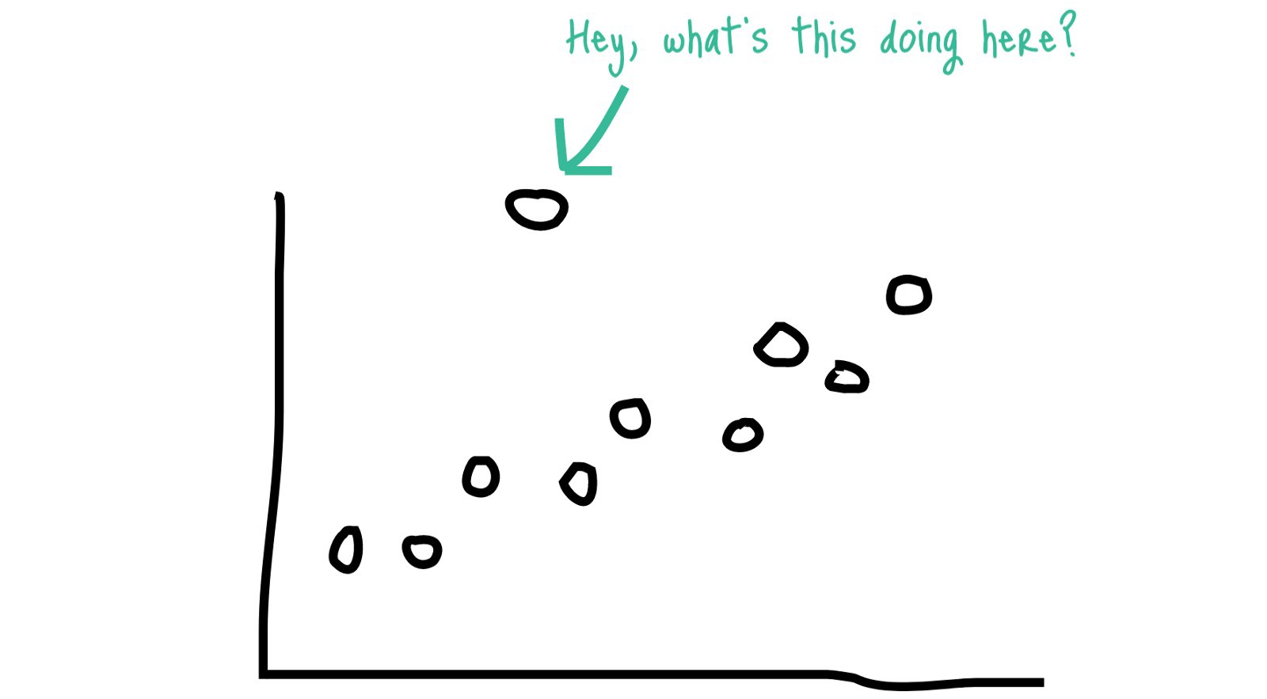
Outliers
Who knows what a outlier is?
Outliers mess up with our statistics models
They are non releval (small data)
And normally due a errors during the capture

Slide 9
Missing data
Normally we don’t have data for all rows….
How we deal with it?
We just discard the full row if one column has missing data?
We can also use statistics to fill the NA (missing data)
For example: fill the NA with the mean of the column

Slide 10
Plotting
There are two main libraries in python to plotting
Matplotlib -> Super powerful but the api is messy (cause it tries to copy from matlab… which is crazy itself xD)
SeaBorn -> a library on top of MatPlotlib with nice design (colors etc..) by default and a understandable api
Guess which one I will use…. But feel free to use whatever you want
https://s3.amazonaws.com/assets.datacamp.com/blog_assets/Python_Seaborn_Cheat_Sheet.pdf
https://s3.amazonaws.com/assets.datacamp.com/blog_assets/Python_Matplotlib_Cheat_Sheet.pdf

Slide 11

Questions

Slide 12
Practice!!!
In pairs or groups (If you want to be alone is fine as well!)
If you feel stuck in something ask for help :)
Start looking at your data
Try to find patterns
Do one submission with the findings
10 min before the end we will share one insight with the full group

Slide 13
Practice!!!
In pairs or groups (If you want to be alone is fine as well!)
If you feel stuck in something ask for help :)
Start looking at your data
Try to find patterns
Do one submission with the findings
10 min before the end we will share one insight with the full group

